Slide 1


Linux Presentation
Presented by- Prasad Yadav
IT Infrastructure Admin

Slide 2
What is Linux & Use of Linux?
Linux, computer operating system created in the early 1990s by Finnish software engineer Linus Torvalds and the Free Software Foundation. Torvalds started developing Linux to create a system similar to MINIX, a UNIX operating system.
Linux is a free, open source operating system, released under the GNU General Public License (GPL). Anyone can run, study, modify, and redistribute the source code, or even sell copies of their modified code, as long as they do so under the same license.
Linux having more advantages when compare to other OS like More Security, Relaible, Software updates availability, more distros,community support, compatibility in all types of hardware, Multi tasking & Lightweight suitable for developers.
At present, Linux distribution software having lot many flavours like Ubuntu, FedoraLinux, Suse Linux, Alpine Linux etc..

Slide 3
Linux Commands
System Commands:
uname -a => Displays Linux system information
uptime => Displays how long the system has been running
including load average
hostname => Shows the system hostname
netstat -pnltu => Displays all active listening port
last reboot (or) last => Shows system reboot history
date => Displays current system date and time
timedatectl => Query and change the System clock
cal => Displays the current calendar month and day
w => Displays currently logged in users in the system
who (or) whoami => Displays who you are logged in as

Slide 4
Hardware Commands:
dmesg => Displays bootup messages
cat /proc/cpuinfo => Displays more information about CPU e.g model, model name, cores, vendor id
cat /proc/meminfo => Displays more information about hardware memory e.g. Total and Free memory
lshw => Displays information about system’s hardware configuration
lsblk => Displays block devices related information
free -m => Displays free and used memory in the system (-m flag indicates memory in MB)
lspci -tv => Displays PCI devices in a tree-like diagram
dmidecode => Displays hardware information from the BIOS
Top => utility which it display the process & their usgae of each and every user

Slide 5
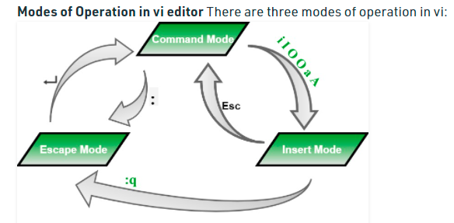
VI Editor: vi filename: Creates a new file if it already not exist, otherwise opens existing file. vi -R filename : Opens an existing file in read only mode. view filename : Opens an existing file in read only mode.
Nano Editor: nano filename : Create a new file/open file to edit

Slide 6
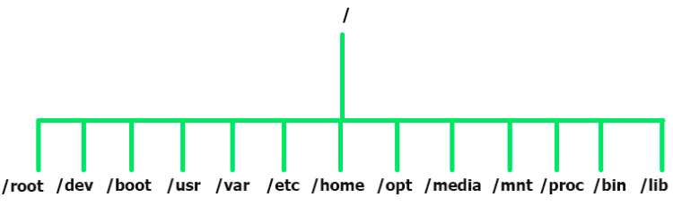
Directory Traverse:
cd .. => Move up one level in the directory tree structure
cd => Change directory to $HOME directory
cd /test => Change directory to /test directory
File Commands:
ls -alrth => Lists files - both regular & hidden files and their permissions as well.
pwd => Displays the current directory file path
mkdir ‘directory_name’=> Creates a new directory
rm file_name => Removes a file

Slide 7
rm -f filename => Forcefully removes a file
rm -rf directory_name => Removes a directory forcefully and recursively
cp file1 file2 => Copies the contents of file1 to file2
cp -r dir1 dir2 => Recursively Copies dir1 to dir2. dir2 is created if it does not exist
mv file1 file2 => Renames file1 to file2
touch file_name => Creates a new file
cat > file_name => Places standard input into a file
more file_name => Outputs the contents of a file
head file_name => Displays the first 10 lines of a file
tail -f wget-log => Displays the wget downloaded file logs
wget -O latest-hugo.pdf https://doc.lagout.org/operating%20system%20/linux/Linux%20-%20The%20Complete%20Reference.pdf
curl -O ftp://speedtest.tele2.net/1MB.zip

Slide 8
wc => Prints the number of bytes, words and lines in a file
File Permission Commands:
chmod octal filename => Change file permissions of the file to octal
Example:
chmod 777 /data/test.c => Set rwx permissions to owner, group and everyone (everyone else who has access to the server)
chmod 755 /data/test.c => Set rwx to the owner and r_x to group and everyone
chmod 766 /data/test.c => Sets rwx for owner, rw for group and everyone
chown owner user-file => Change ownership of the file
chown owneruser: owner-group file_name => Change owner and group owner of the file
chown owneruser:owner-groupdirectory => Change owner and group owner of the director

Slide 9
Search Commands:
grep ‘pattern’ files => Search for a given pattern in files
grep -r pattern dir => Search recursively for a pattern in a given directory
find /[directory path] -type d -name [directory name] => Find dir name that begin with directory_name in /directory path folder
find /home -size +10000k => Find files greater than 10000k in the home folder
Process Related :
ps => Display currently active processes
ps aux | grep ‘sshd’ => Searches for the id of the process ‘telnet’
ps -u => user related running process
Ps -A => List of all processes
top => Displays all running processes

Slide 10
kill pid => Terminates process with a given pid
Kill -L => List of all signal to kill the process
pkill process-name => Sends a signal to a process with its name
bg => Resumes suspended jobs in the background
fg => Brings suspended jobs to the foreground
nice -n [value] [process name] => Start a process and give it nice value
renice [value] -p PID => change nice value of a process that is already running use
pstree => Visualizing processes in tree mode
User Commands:
id => Displays the details of the active user e.g. uid, gid, and groups
last => Shows the last logins in the system

Slide 11
su - [username] => switch from one user to another user
adduser “Sam” => Adds user Sam
userdel “Sam” => Deletes user Sam
passwd [Username] => prompts to change username password
chage -l [username]
Remote Login Commands:
ssh user@host => Securely connect to host as user
ssh-keygen => generate ssh public & private key in .ssh directory.
ssh-copy-id -i ~/.ssh/id_rsa.pub user@host
ssh -p [port_number] user@host => connect remote with particular port.
sudo vim /etc/ssh/sshd_config => ssh Configuration file
systemctl restart sshd => to restart sshd service
systemctl enable sshd => to enable sshd service

Slide 12
File transfer commands:
scp [src_filename] user@hostname:[dest-path] => Securely copy src file to remote server in the dest-path
rsync -a dir_name remote_user@remote_host_or_ip:dir-name => Synchronize contents in src_dir_name directory with dest directory
Network Commands:
ip addr show => Displays IP addresses and all the network interfaces
ip address add 192.168.0.1/24 dev eth0 => Assigns IP address 192.168.0.1 to interface eth0
ifconfig => Displays IP addresses of all network interfaces
ping host => ping command sends an ICMP echo request to establish a connection to server / PC
nmcli general (or) nmcli dev status => Display List of available connections
nmcli general hostname [change_Hostname]=> update the hostname

Slide 13
nmcli con add con-name eth2 type ethernet ifname eth2 ipv4.method manual ipv4.address 10.10.10.4/24 ipv4.gateway 10.10.10.1
Connection 'eth2' (460b16aa-e755-403e-b0ec-5e1560dcc441) successfully added=> create new ethernet connection and assign static IP Address.
nmcli con add con-name eth2 type ethernet ifname eth2 ipv4.method auto
Connection 'eth2' (d75cb87f-cd15-40a2-9c33-138e69a06a1f) successfully added => create new ethernet connection and assign DHCP IP Address.
Disk Usage Commands:
df -h => Displays free space on mounted systems
df -i => Displays free inodes on filesystems
fdisk -l => Shows disk partitions, sizes, and types
du -sh => Displays disk usage in the current directory in a human-readable format
free -m => Display the ram and swap usage
mount device-path mount-point=> Mount a device

Slide 14
Compression/ Archive commands:
tar -cvf filename.tar dir_path => Creates archive file called ‘home.tar’ from file ‘home’
tar -xvf filename.tar => Extract archive file ‘files.tar’
tar -zcvf home.tar.gz source-folder => Creates gzipped tar archive file from source folder
zip -r filename.zip folder => Compression a file with .zip extension
Package management commands:
yum install package_name => Install package through yum
yum remove pkg_name => Removes a package through yum
dnf install pkg_name => Install package using dnf utility
dnf remove pkg_name => Remove a package using dnf utility
Yum list package_name => List the package available/not in repository.

Slide 15
Firewall Commands:
firewall-cmd –list-all-zones => List info for all zones
firewall-cmd –get-default-zone => Display the current default zone
firewall-cmd –list-services => List allowed service on the system
firewall-cmd –list-ports => List allowed ports on the system
firewall-cmd --permanent --zone=public –add-service=[service name] =>
Enable incoming ports for a service permanently
firewall-cmd --permanent --add-port=[YOUR PORT]/tcp => Allow traffic on an incoming port permanently
Start, Stop & check the status of firewall service
systemctl start firewalld.service
systemctl stop firewalld.service
systemctl status firewalld.service

Slide 16
CronJobs:
configure a cron job to schedule scripts or other commands to run automatically. Below Crontab Syntax & example execution:
MIN HOUR DOM MON DOW CMD
[0-59] [0-23] [1-31] [1-12] [0-6] Any command to be executed
An asterisk (*) stands for all values. Use this operator to keep tasks running during all months, or all days of the week.
A comma (,) specifies separate individual values.
A dash (–) indicates a range of values.
A forward-slash (/) is used to divide a value into steps. (*/2 would be every other value, */3 would be every third, */10 would be every tenth, etc.)
Crontab -l => check list of cronjobs for all users
Crontab -e => to edit cron job

Slide 17
What is Version Control & it's Use?
Version Control is a system that documents changes made to a file or a set of files. It allows multiple Users to manage multiple revisions of the same unit of information. It's a snapshot of your project overtime.
A central repository is maintained where all the versioned files are kept.
Now users can check-out & check-in files from different computers at any time.
If any of the servers distracted/corrupted, a client server can be used to restore by using distributed version control system.
Backup is possible with out any data loss with these version control.
Any one can able to store data /restore data from remote server at any time.
Distributed version control systems and tools help developers track code, manage simultaneous branch check-ins, and undo things -- a capability used by nearly all development teams. Tracked code changes also save resource time when developers attempt code reviews or reuse components.

Slide 18
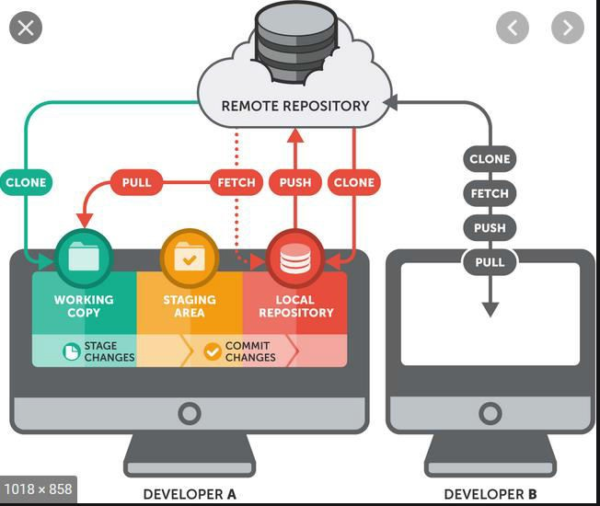
Git Distributed Versioning Control Tool
Architecture:

Slide 19
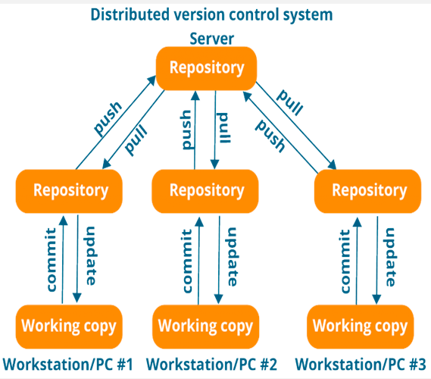
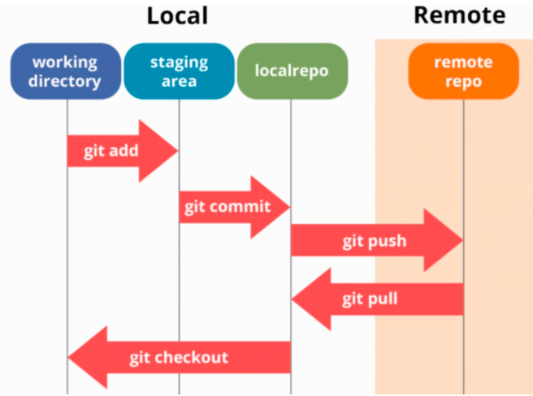

Slide 20
Setup & init Commands:
git init => initialize an existing directory as a Git repository
git config --global user.name “[firstname lastname]” => set a name that is identifiable for credit when review version history
git config --global user.email “[valid-email]” =>set an email address that will be associated with each history marker
git ls-files => list out the commited files
git rm [filename] => It removed the file in git local repo & in working dir
git rm –cached [filename] => Removed file in local repo not in working dir
git restore [filename] => restore file from working dir to local repo
git revert [commit_id] => undo the changes of a commited file
git reset --hard [commit_id] => remove commit's permanently(destructive)
git reset --soft [commit id] => remove commit's and stayed in staging
git reset --mixed [commit id] => remove commit's and stayed in work dir

Slide 21
STAGE & SNAPSHOT:
git status => to check the files are tracked/untracked
git add [file] => Moving files from working copy to staging area
git diff [filename] => diffrence between tracked and untracked file content
git diff –staged => staged changes before commit
git commit -m “[descriptive message]” => Moving files from staging area to localrepo
git log --oneline [branchname]
BRANCH & MERGE:
Git branch [child branch] [parent master branch]
Git checkout [branch-name] => branch change
Git merge [src branch] [dest branch] =>push data from one branch to another
Git rebase [branchname] => push data in a linear way.

Slide 22
TEMPORARY COMMITS
git stash => files moved to temporary shelves
git stash list => listing the stash files
git show stash@{0} => Showing the files & content in stash
git stash -p => Partial stash like what ever files we can selet to stash it
git stash pop stash@{0} => undo the stash and files will be back to work
git stash apply stash@{0} => Undo the stash and also stash list will not dropped
git stash drop stash@{0}=> remove/delete the all stash@{0}
git stash clear => clear all stash list
git status
git log --follow [file]
git log [branchname]

Slide 23
Remote to local data & vice versa updating:
git remote add origin [url<https:github.com/username/repo.git>] =>
Connect to remote repo by using above command
git remote -v => checking remote repo connected/not
git push origin [branchname] => pushing from local to remote
git pull origin => pulling data from remote to local(fetch + merge)
git fetch origin => Show the updates not update any thing
git clone [url<https:github.com/username/repo.git>] => Clone repo
Directory from remote to local along with .git

Slide 24

Contact me if you have any doubts:
9513031322
Prasad.vullipayala@technoidentity.com
We see you soon with Cloud Real Time Infrastructure Creation.

